Slide 1
Drug Persistency Classification
Process and Insights

Slide 2
Persistence
Target variable -> What is persistence?
Medication Persistence refers to how long the patient follows the prescribed interval, the dosage of the medication, and treatment regimen
Problem Statement: Which factors affect the persistency of drug use / treatment regimen?
Importance
Enhance patient care and outcomes
Insights for Pharmaceutical Companies and Local Pharmacies
Improve strategic planning in regards to patient care and wellness

Slide 3
Dataset
Retrieved from Kaggle, Usability Rating of 9.41
Four Main Factors:
Variable Description
Patient Information (Age, Race, Gender, etc.)
Provider Attributes
Physician Specialty
Clinical Factors
Clinical Treatments directly associated to patient treatment during their therapy
Disease/Treatment Factor
Broader View of patient medical history and ongoing regimen (Comorbidity, Concomitancy, Injectable Experience, etc.)
Comorbidity: presence of additional diseases or conditions that patient may have, can affect plans and outcomes
Concomitancy: Concomitant drugs recorded prior to starting with therapy (within 365 days prior from first rxdate
Notes:
Comorbidity -> refers to the presence of additional diseases or conditions that the patient might have, which can affect treatment plans and outcomes
Concomitancy -> Concomitant drugs recorded prior to starting with a therapy(within 365 days prior from first rxdate)

Slide 4
Data Cleaning Process
Steps taken to clean the dataset
Exploratory Data Analysis
Understand features, values, and null data
Dealing with Null Values
Thresholds determined dropping observations vs. features
Imputing with mode (categorical) or median (numerical)
Dealing with Numerical Data
1 pipeline per scaler, used MinMaxScaler and StandardScaler
Dealing with Categorical Data
Binary Mapping and One-Hot Encoding
Feature Correlation
Highly correlated non-target features removed (2 features removed)
Non-target features with no correlation to target removed (78 features removed)

Slide 5
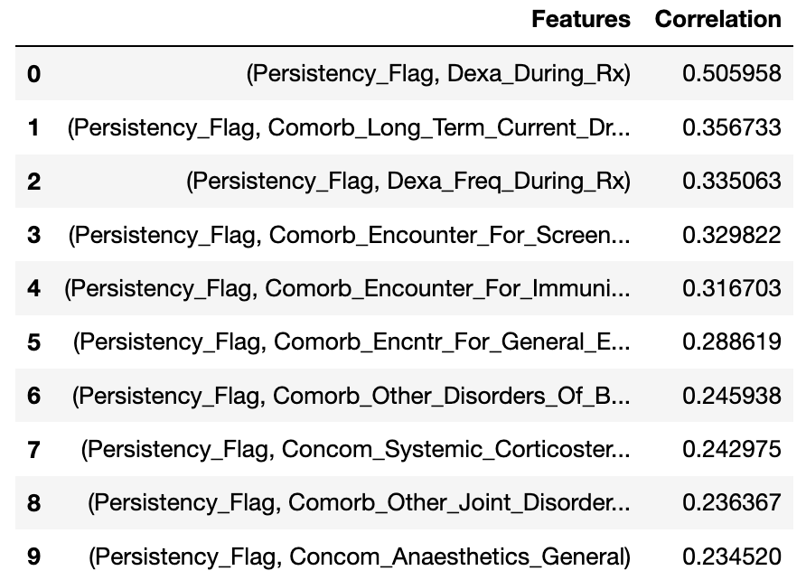
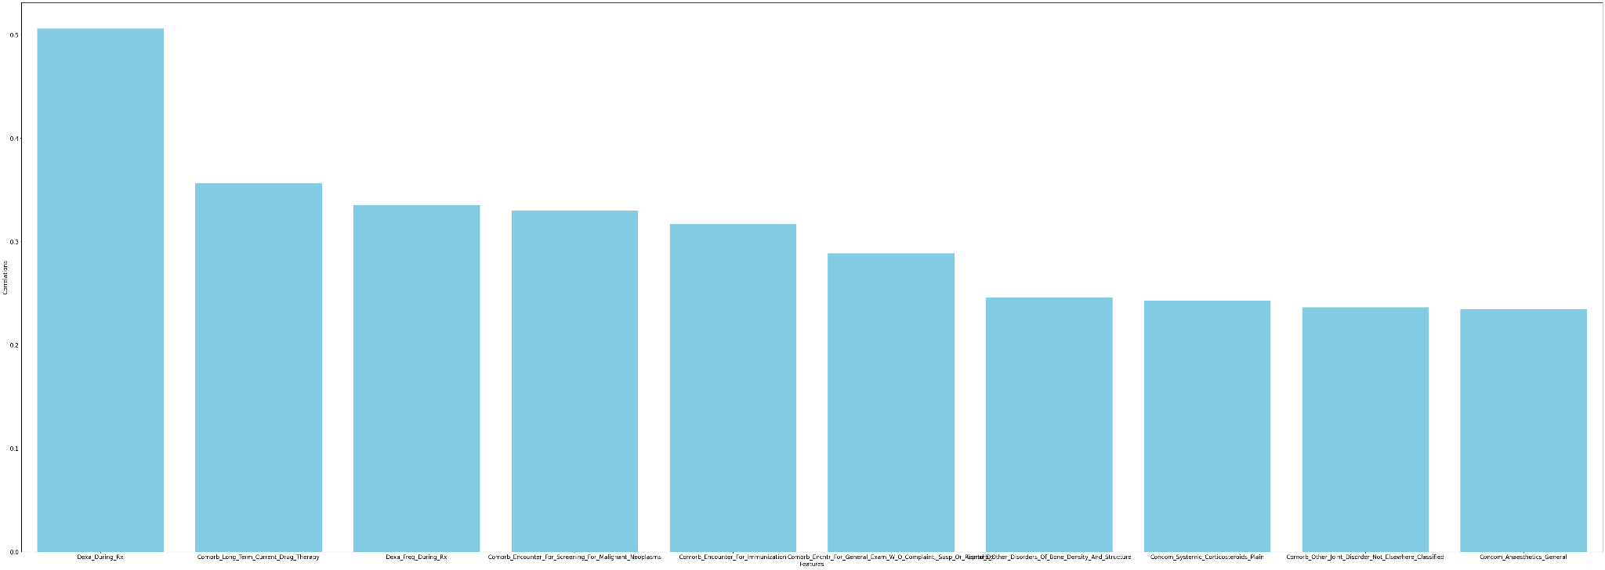
Data Visualization
Graph of top 10 features with the highest correlations to the target
Dexa During RX
Comarb Long Term Current Drug Therapy
Comarb Encounter For Screening For Malignant Neoplasm
Comarb Encounter For Immunization
Comarb Encounter For General Exam w/o Complaint
Dexa Freq During RX
Reported Other Disorders of Bone Density & Structure
Concom Systemic Corticosteroids Plain
Comorb Other Joint Disorder Not Elsewhere classified
Concom Anaesthetics General

Slide 6
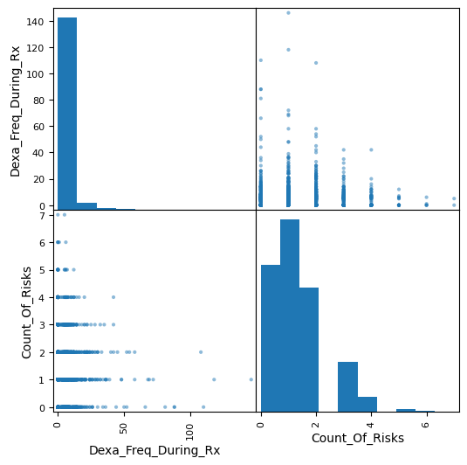
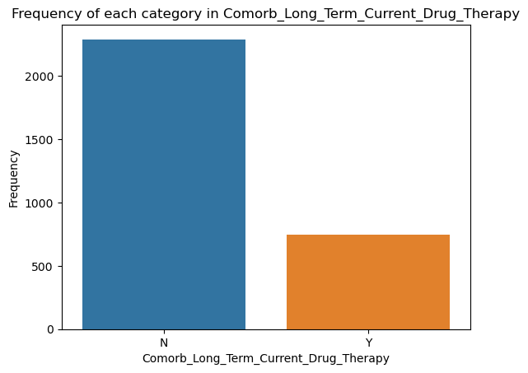
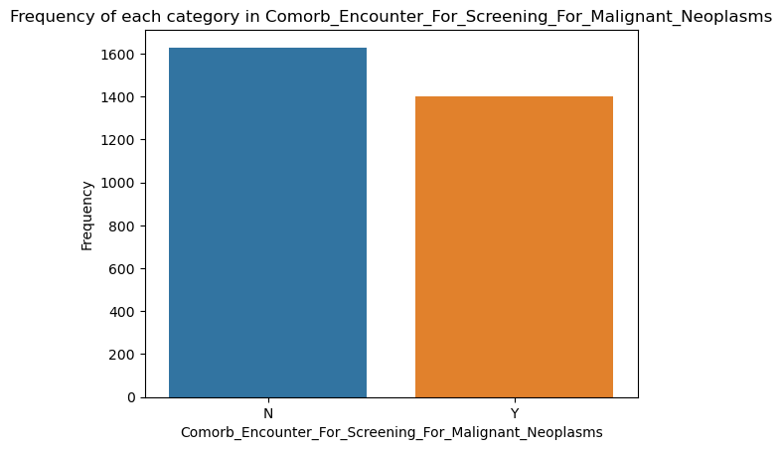
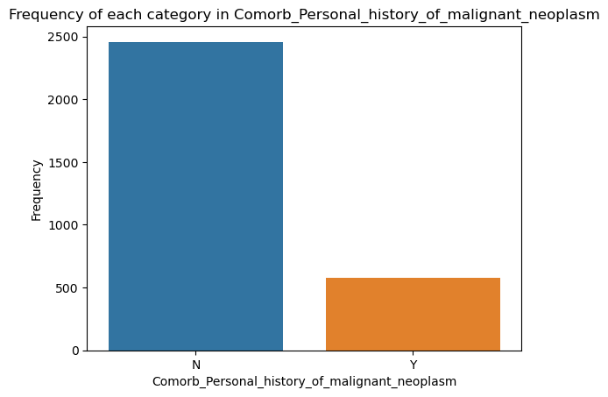
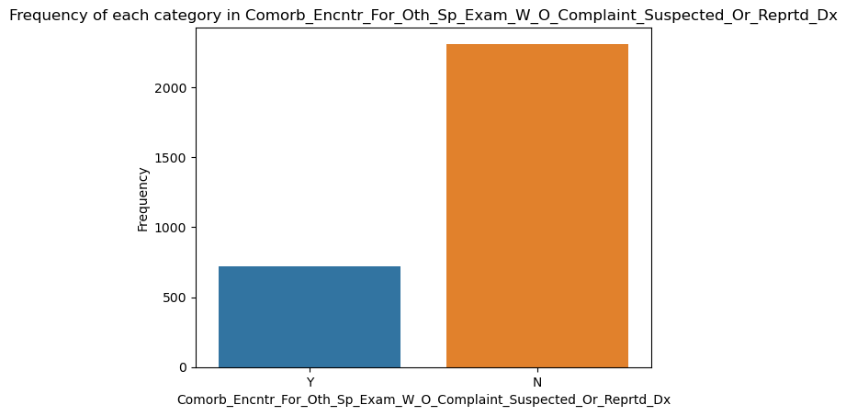
Data Visualization
Categorical Features Frequency tables with the highest correlation
Visualization of the numeric features

Slide 7
Models and Evaluations

Slide 8
Models - Training
Generalized Approach to Model Training and Functions Used
Functional Approach
Process
Models utilize GridSearchCV() to hyper-parameter tune
run_grid_search()
Evaluation done in the same manner
eval_report()
Data Structures for later reference of trained models
models_log, update_models()
Define Model
Hyperparameter tune (GridSearch + Training Subset)
Evaluate on Validation Set
Instantiate Final Model (Hyperparameter from 2)
Fit on full Training Set
Evaluate on Test Set
(If applicable) Record Feature Weights
Save Results for later reference

Slide 9
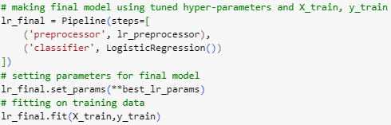
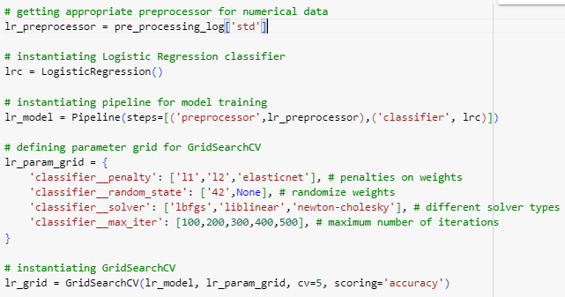

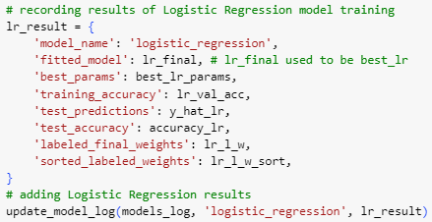
Models - Training (cont.)
Logistic Regression Example

Slide 10
Models - Model Selection
Which models are chosen, Why we chose these models
Approach
Wanted wide array of models
Linear Models: Stochastic Gradient Descent, Logistic Regression
Naive Bayes
K-Nearest Neighbors
Tree Methods: C.50, CART, Random Forest
Support Vector Machine
Neural Network: Multi-Layer Perceptron
Mix between complex and simple
Relation to Dataset
Can deal with variety of data distributions
Most data was categorical, without much strong correlation to target

Slide 11
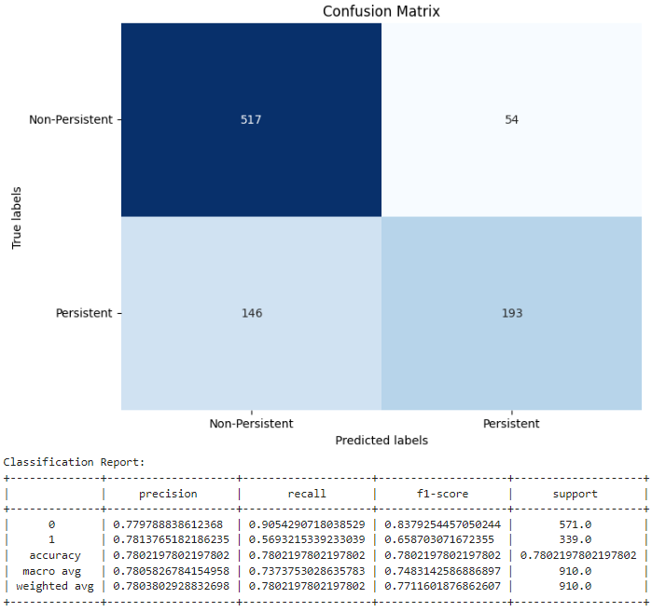
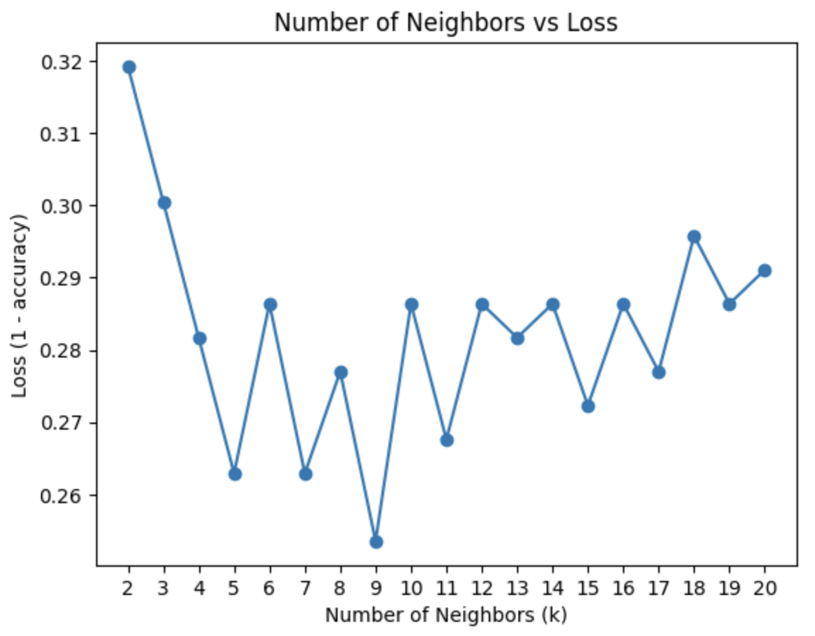
K Nearest Neighbor (KNN) - Elbow
Based upon the elbow method, the ideal number of neighbors to use is k = 5. Presenting a training accuracy of 0.7089 and testing accuracy of 0.7802.

Slide 12
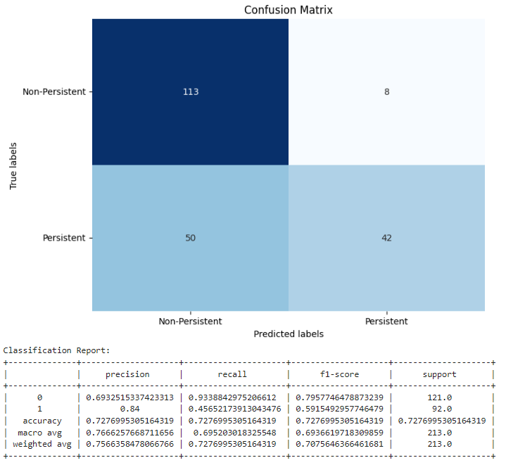
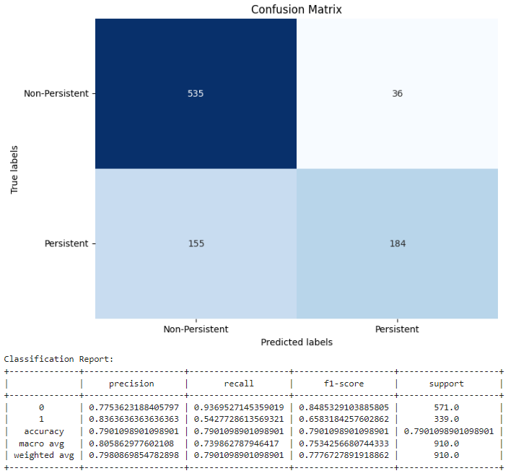
K Nearest Neighbor (KNN) - Grid Search
Training accuracy of 0.7277 and testing accuracy of 0.7901. Based on the two methods, Grid Search approach works better at predicting the class of observation.
Validation Confusion Matrix and Classification Report (Training)
Testing Confusion Matrix and Classification Report

Slide 13
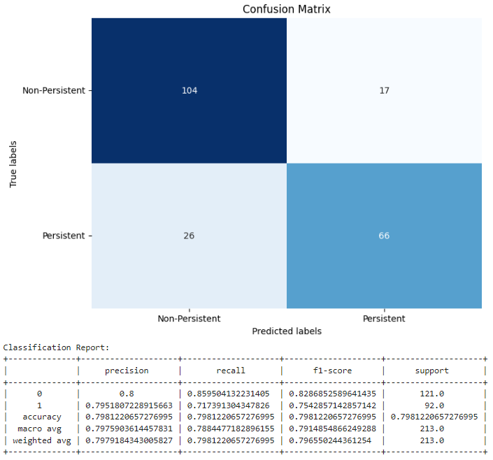
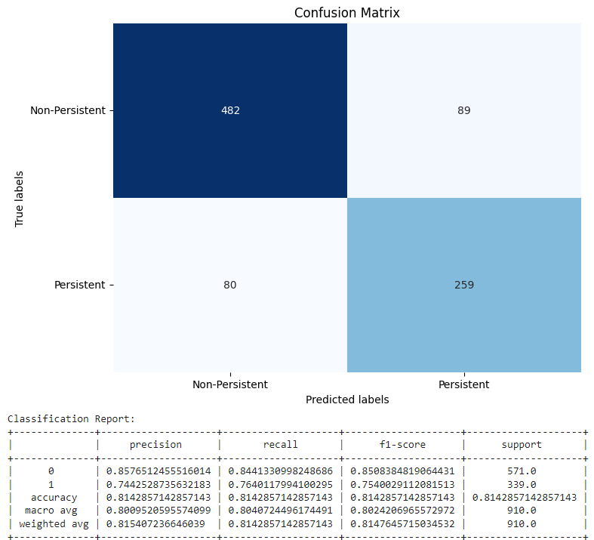
Naive Bayes
Validation Confusion Matrix and Classification Report (Training)
Accuracies:
Training: 0.7981
Testing: 0.8143
Parameters used for Final Model:
alpha = 10
fit_prior = True
Top 2 Factors based on weight: unable to get weights due to categorical data
<- Testing Confusion Matrix and Classification Report

Slide 14
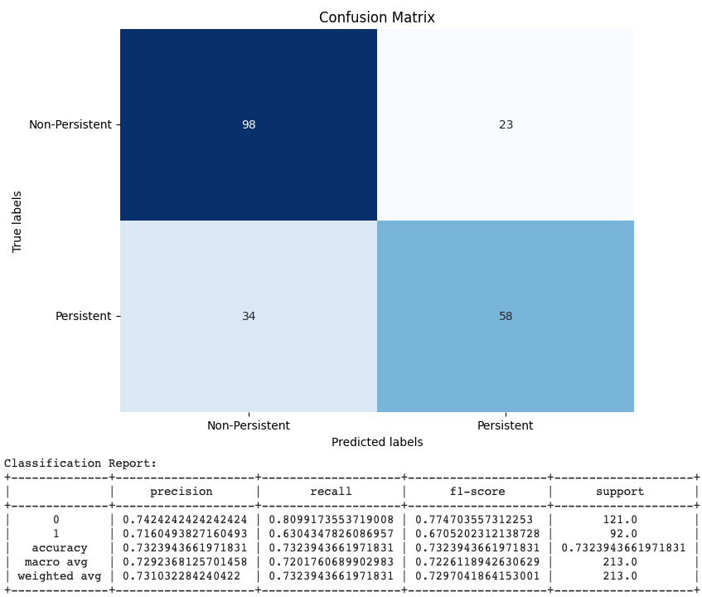
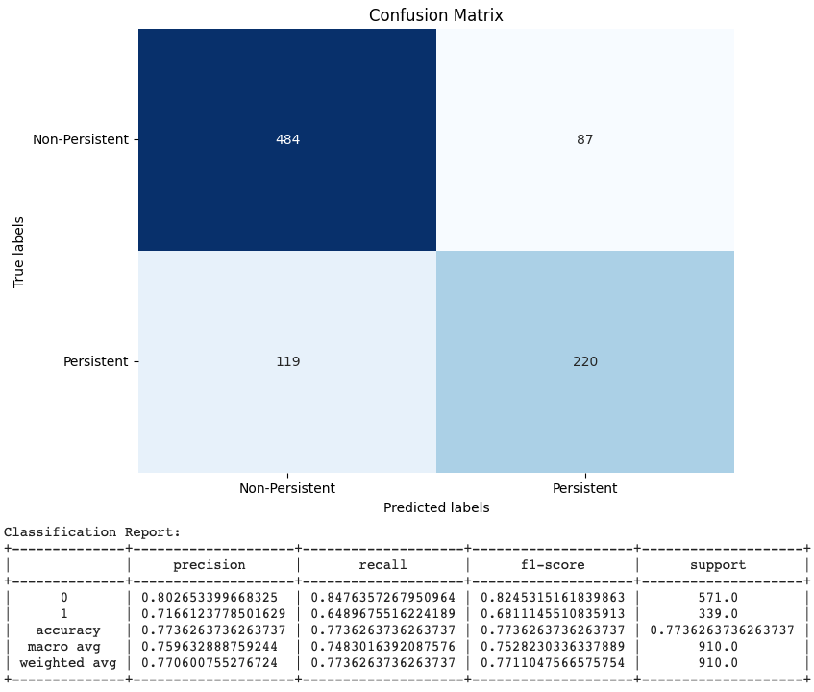
C5.0
Validation Confusion Matrix and Classification Report (Training)
Accuracies
Training: 0.7324
Testing: 0.7736
Parameters used for Final Model:
criterion = entropy
min_samples_leaf = 5
min_samples_split = 2
random_state = 8
splitter = best
Top Feature Weights
Dexa_Freq_During_Rx (0.372456)
Comorb_Encounter_For_Immunization(0.078817)
<- Testing Confusion Matrix and Classification Report

Slide 15
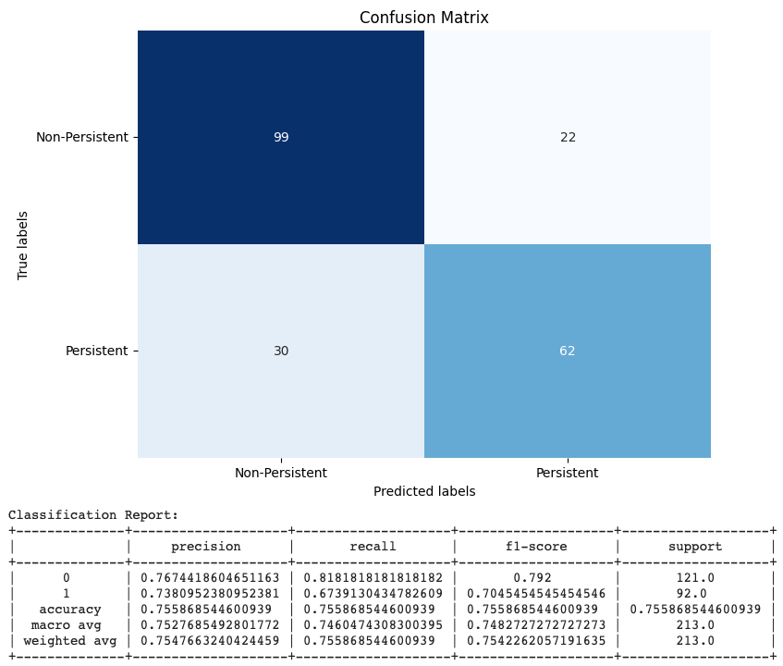
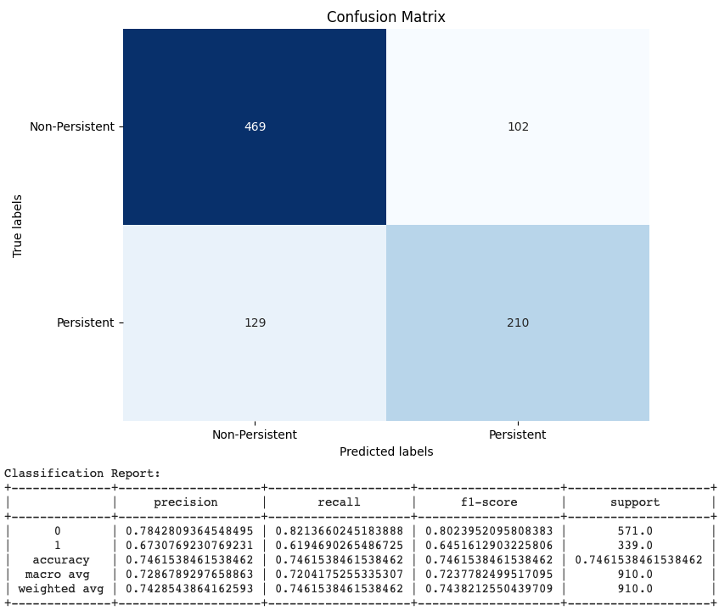
CART
Validation Confusion Matrix and Classification Report (Training)
Accuracies
Training: 0.7559
Testing: 0.7462
Parameters used for Final Model:
criterion = gini
min_samples_leaf = 5
min_samples_split = 2
Top 2 Factors based on weight:
Dexa_Freq_During_Rx (0.456555)
Comorb_Encounter_For_Immunization (0.076757)
<- Testing Confusion Matrix and Classification Report

Slide 16
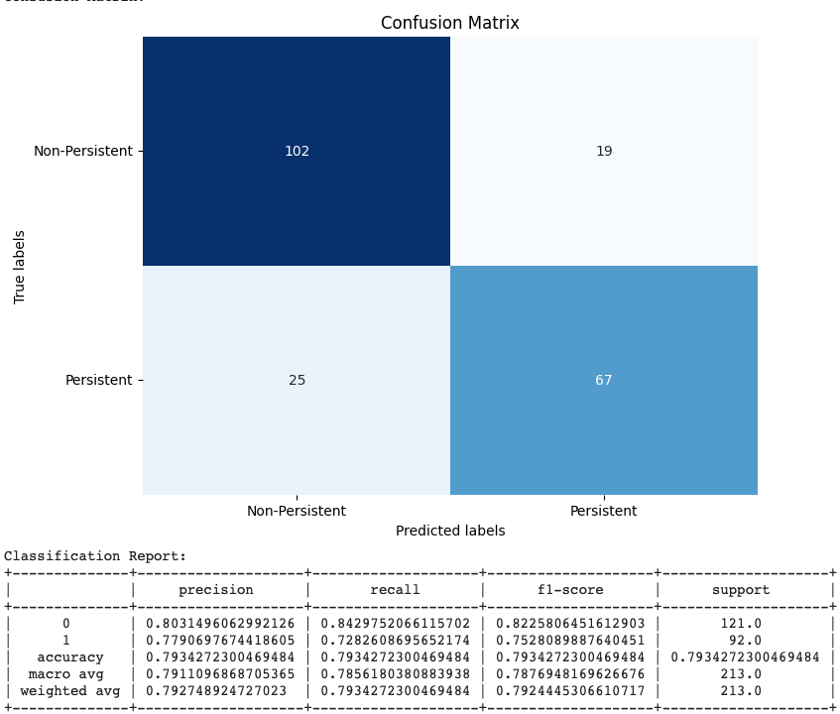
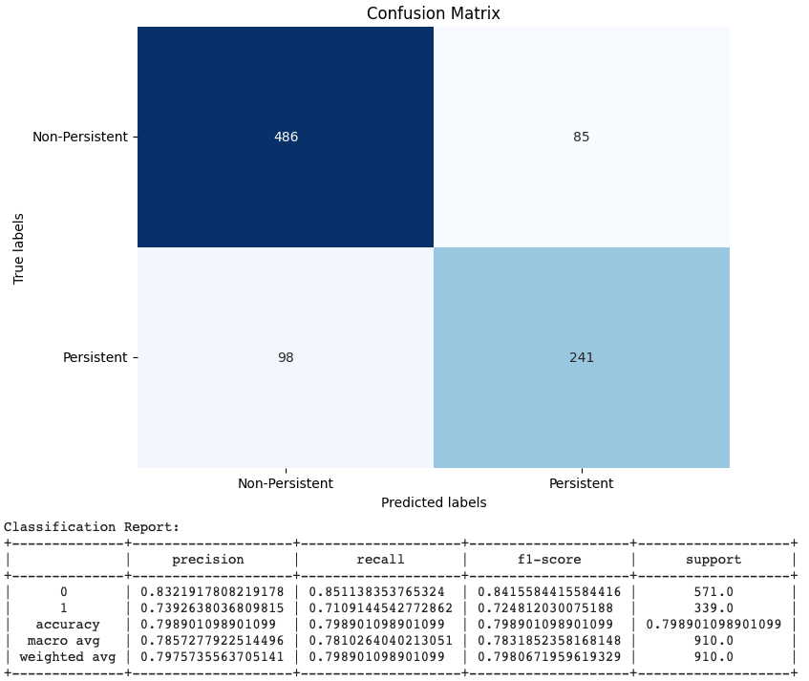
Random Forest
Validation Confusion Matrix and Classification Report (Training)
Accuracies
Training: 0.7934
Testing: 0.7989
Parameters used for Final Model:
criterion = entropy
min_samples_leaf = 1
min_samples_split = 5
n_estimators = 100
random_state = 8
Top Feature Weights
Dexa_Freq_During_Rx (0.139857)
Dexa_During_Rx (0.087428)
<- Testing Confusion Matrix and Classification Report

Slide 17

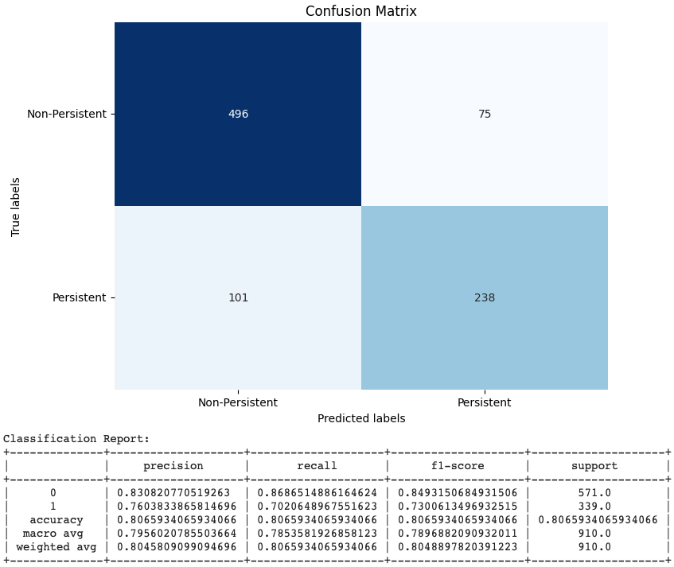
Support Vector Machine (SVM)
Validation Confusion Matrix and Classification Report (Training)
Accuracies:
Training: 0.7981
Testing: 0.8066
Parameters used for Final Model:
degree = 2
gamma = scale
kernel = rbf
random_state = 8
Top 2 Factors based on weight: N/A since best kernel is not linear
<- Testing Confusion Matrix and Classification Report

Slide 18
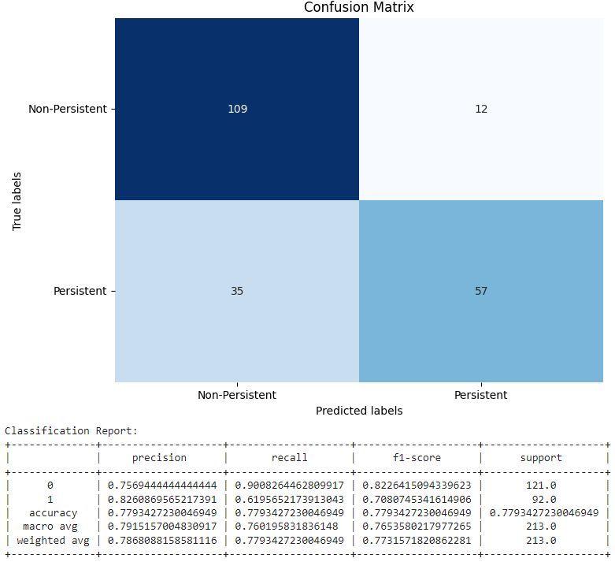
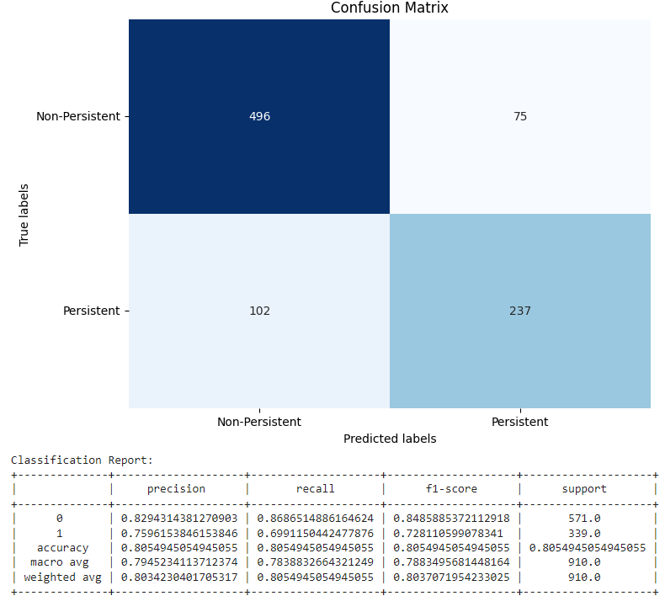
Stochastic Gradient Descent
Validation Confusion Matrix and Classification Report (Training)
Accuracies:
Training: 0.7793
Testing: 0.8055
Parameters used for Final Model:
alpha= 0.01
max_iter= 1000
penalty= 12
Top 2 Factors based on weight:
Dexa_During_Rx (0.912923)
Comorb_Long_Term_Current_Drug_Therapy (0.527049)
<- Testing Confusion Matrix and Classification Report

Slide 19
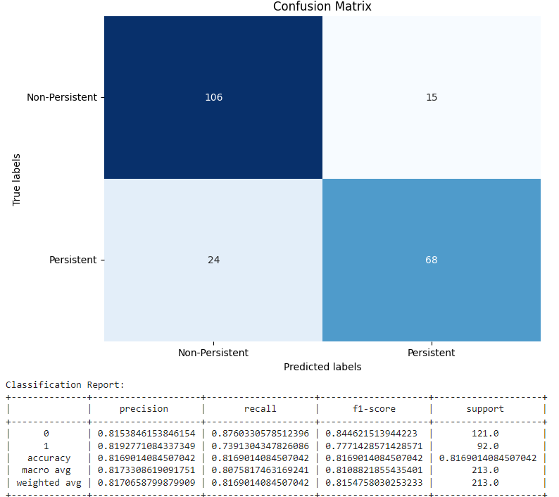

Logistic Regression
Validation Confusion Matrix and Classification Report (Training)
Accuracies:
Training: 0.8169
Testing: 0.8077
Parameters used for Final Model:
max_iter= 100
penalty= l1
random_state = None
solver = liblinear
Top 2 Factors based on weight:
Dexa_During_RX (1.714564)
Comorb_Long_Term_Current_Drug_Therapy (0.823647)
<- Testing Confusion Matrix and Classification Report

Slide 20
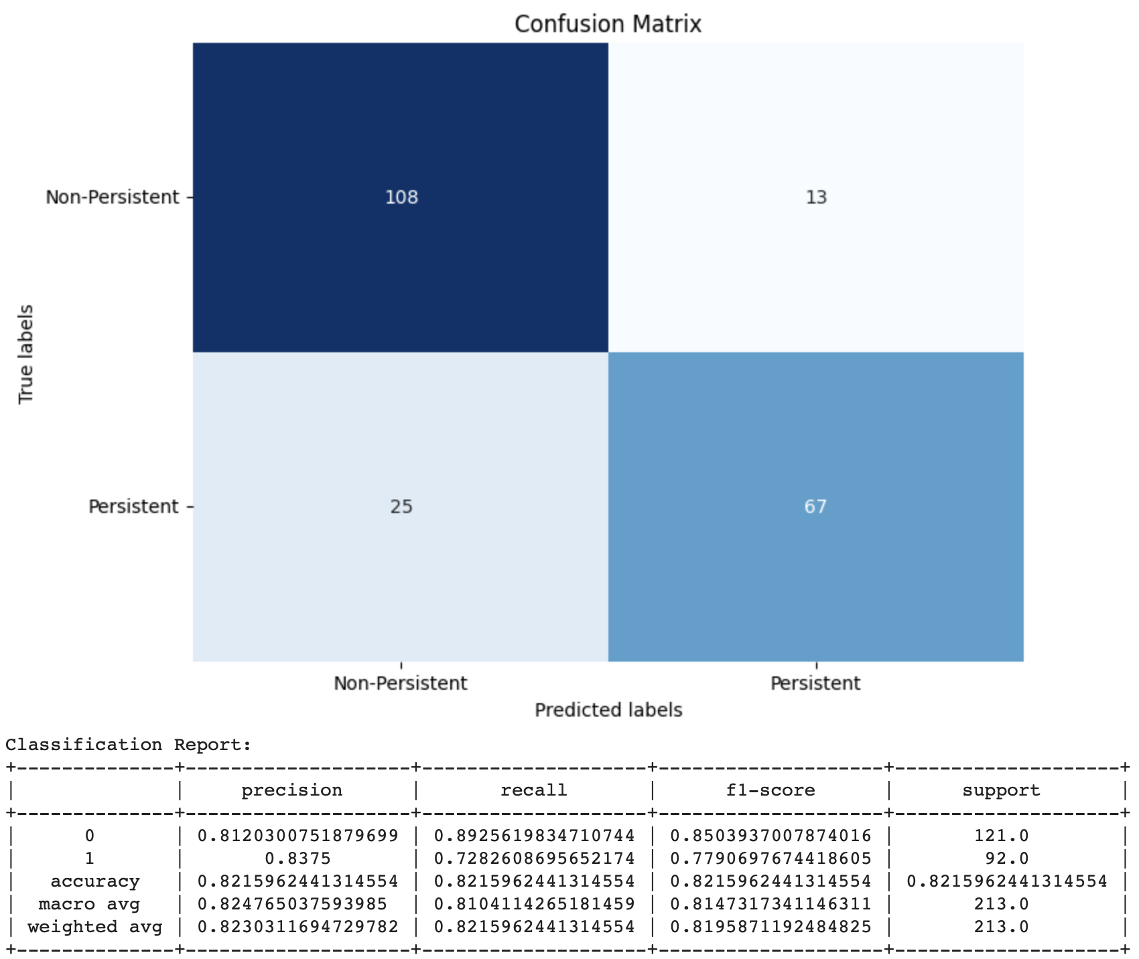
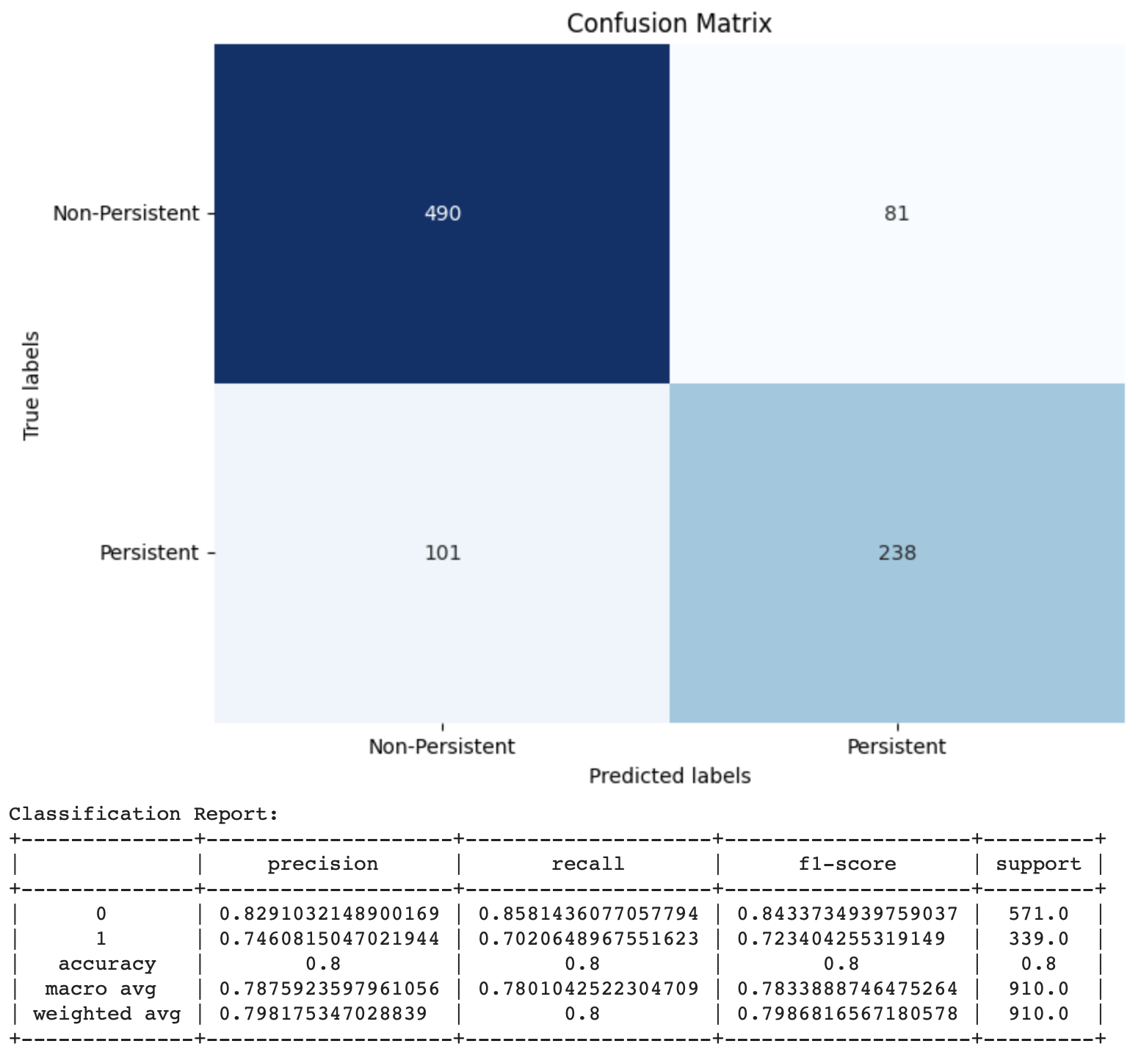
Neural Network (Multi-Layer Perceptron)
Validation Confusion Matrix and Classification Report (Training)
Accuracies:
Training: 0.8216
Testing: 0.8
Parameters used for Final Model:
activation= ‘tanh’
early stopping= True
max_iter = 200
random state = 1
solver = adam
Top 2 Factors based on weight:
N/A since best kernel is not linear
<- Testing Confusion Matrix and Classification Report

Slide 21
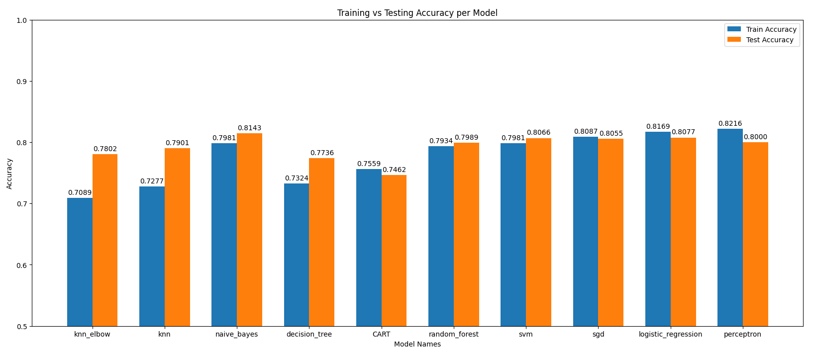
Overall Model Performance
Breakdown of Target
Persistent: 0.3844
Non-Persistent: 0.6156
Best Performing Model
Naive Bayes

Slide 22
Final Thoughts

Slide 23
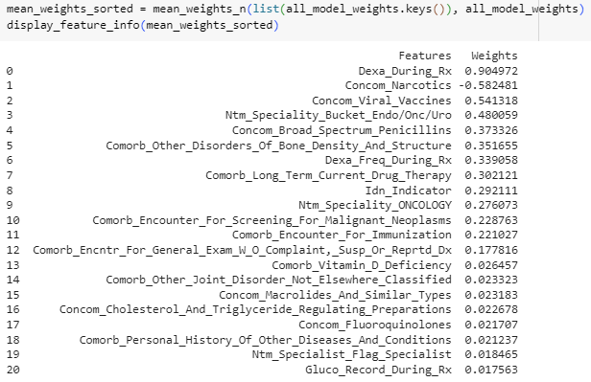
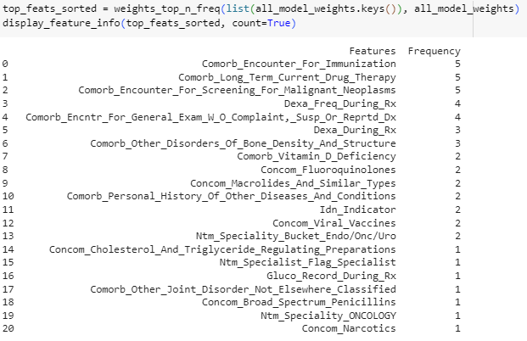
Conclusion
Analysis on top 10 feature weights for each applicable model
Mean Feature Weights Across Models Sorted by Magnitude
Frequency a Feature is a Top 10 Weight Across Models

Slide 24
Conclusion (Cont.)
Reading Weights and Frequency
Positive weights → Persistent, Negative weights → Non-Persistent
Higher Frequency → More often it is a top 10 feature across models
Features to Note:
Dexa_During_Rx
Most common factor to affect Persistency
DEXA is a specialized x-ray scan to measure bone density
A patient is more likely to be persistent with their medication if they have frequent DEXA scans because they are in frequent contact with their doctor and medical testing.
Comorb_<One-Hot Encoded Feature>
Multiple One-Hot Encoded features included Comorb → Comorbidity is a commonality
Comorb_<> have positive mean weights → Persistent prediction
Concom_Narcotics
Presence of narcotics within patient medical records leads to non-persistence when starting a new therapy regimen

Slide 25
Thank You!
Any Questions?

